Slide 1

Laptop Price Prediction System
Project guide :
Mrs. Sunita M. Dol
Members :
Aditya Waykos(57)
Sanket Raone (56)
Sammed Singalkar(58)
Sakshi Nagarkar(59)

Slide 2
BACKGROUND OF PROJECT
Many People Facing problem in choosing and buying a laptop online or offline
It might be confusion how much we should have to spend on the particular specified laptop.
Different brands have their different price range for same specifications .
If any user wants to buy a laptop then our website will provide them a tentative price of laptop according to the their configuration requirements.

Slide 3


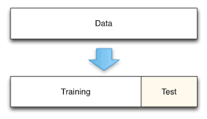

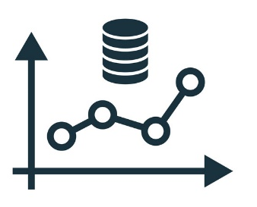
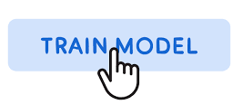
SYSTEM ARCHITECTURE .
Data Cleaning & Feature Selection
Data Gathering
Splitting Test-Train
Prediction on Cleaned Data
Training models
Get Prediction

Slide 4
METHODOLOGY ( WORKING ) .
Dataset :
Screen Resolution, Ram, Memory, OS, Weight, Price .
Features Selection :
Ram, Memory, GPU, OS, Price.
ML Algorithms :
Bagging and Radom Forest.
Company, Model Name, Screen Size ,CPU, GPU,
Company, Inches, CPU, Screen Resolution,
KNN, SVM, Decision Tree, Linear Regression,
Graphs :
Statistical Charts .

Slide 5
TECHNOLOGY STACK .
Back-End
Front-End
Python
Django/Flask
Machine Learning
HTML
CSS
JavaScript

Slide 6
Plan For Next 2 Months
Cleaning of Dataset.
Implementation of various algorithms.
Selection of algorithm based on BEST SCORE.
Designing WEB UI and connecting with Flask server.
Testing site.

Slide 7
Work Distribution &
Plan among Students
Data-Cleaning
Selection of Algorithm
Data Analysis
Front-End
Connectivity
Testing
Sanket Raone
Aditya Waykos
Aditya Waykos
Sakshi Nagarkar
Sammed Singalkar
Sanket Raone
Sammed Singalkar
Sakshi Nagarkar
Sammed Singalkar
Sanket Raone
Aditya Waykos
Sanket Raone

Slide 8
THANK YOU …..

